Slide 1
Secure Data Hiding in Image Using Steganography
CAPSTONE PROJECT
Presented By: Rupal Porwal
Student Name : Rupal Porwal
College Name: Devi Ahilya University, Indore
Department : School of Computer Science & IT, Davv

Slide 2
OUTLINE
Problem Statement
Technology used
Wow factor
End users
Result
Conclusion
Git-hub Link
Future scope

Slide 3
Problem Statement
Develop a steganography-based system that allows users to hide a secret message within an image (encryption) and later retrieve the hidden message (decryption) while ensuring data security.
On Encryption Side : Embed a text message within an image by modifying pixel values without significantly altering the image’s appearance.
On Decryption Side : Extract the hidden message from the modified image using a predefined passcode.

Slide 4
Technology used
Programming Language: Java Programming for encryption and decryption logic.
Libraries & APIs:
javax.imageio.ImageIO for image processing.
java.awt.image.BufferedImage for reading/writing pixel data.
java.io.File for File handling.
Platform: Windows Operating System, Java Runtime Environment (JRE) To execute the Java Source program and VS Code for development as IDE.

Slide 5
Wow factors
The Project has the Following WOW features
1.Image-Based Steganography: Unlike traditional text or file encryption, this project hides messages within an image’s pixel values, making the data almost undetectable.
2. Passcode Protection: Only users with the correct passcode can decrypt and retrieve the hidden message, adding an extra layer of security.
3. Customizable & Scalable: The project can be extended to support different image formats, larger messages, and stronger encryption algorithms.
4. Cross-Platform Compatibility: Runs on Windows, macOS, and Linux with just Java and no need for specialized hardware.
5. Minimal Data Distortion:The encryption process modifies pixel values without significantly changing the image’s appearance, ensuring secrecy.

Slide 6
End users
End Users of This Application
1.Government & Defense Agencies:Used for covert communication and secure data transmission without raising suspicion
2. Cybersecurity Professionals & Ethical Hackers: Can test and analyze steganographic techniques for security research and digital forensics.
3.Individuals & Privacy Enthusiasts:People who want to securely hide personal or sensitive information within images for private communication.
4.Organizations & Businesses :Companies can use it for secure watermarking, document verification, and intellectual property protection.

Slide 7
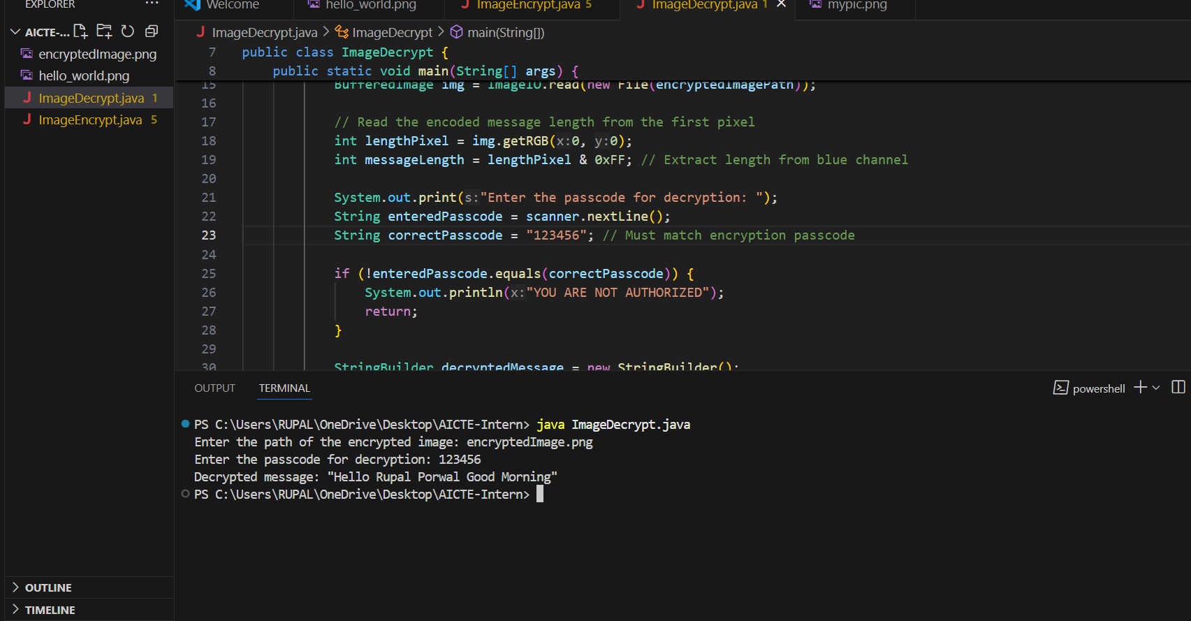
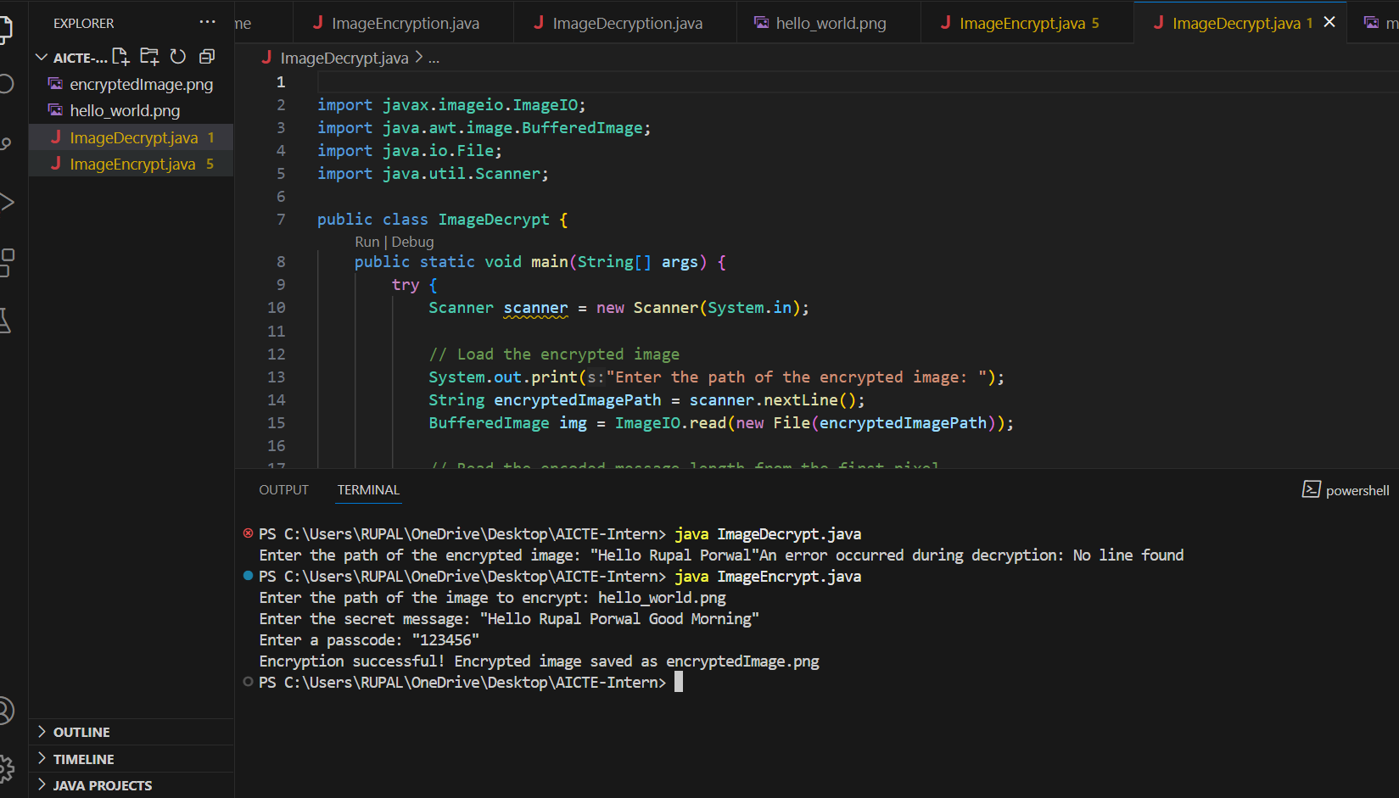
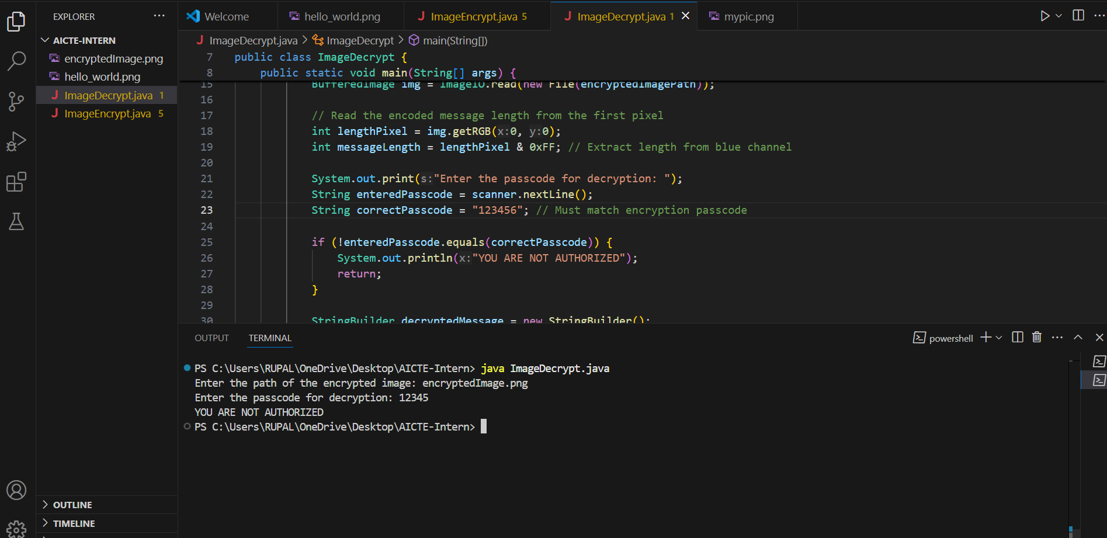
Results
Image_Decryption
Image_Encryption

Slide 8
Conclusion
This project successfully implements steganography-based encryption and decryption to securely hide and retrieve messages within images. By embedding text into pixel values while maintaining the image’s visual integrity, it ensures confidentiality and undetectability. The integration of passcode protection adds an extra layer of security, making it suitable for private communication, digital watermarking, and secure data transmission.
With its cross-platform compatibility, minimal data distortion, and scalability, this system stands out as an innovative solution for individuals, businesses, and security professionals seeking covert and secure information exchange.

Slide 9
GitHub Link
https://github.com/2001Rupal/Stenography_AICTE

Slide 10
Future scope(optional)
1.Advanced Encryption Techniques: Integrate stronger cryptographic algorithms (AES, RSA) to enhance security beyond basic steganography.
2. AI-Powered Steganography:Use machine learning to improve data hiding efficiency and make detection even harder.
3. Support for Multiple File Formats:Extend beyond images to support audio, video, and PDF steganography for broader applications.
4. Real-Time Steganographic Messaging:Develop a mobile or web-based chat application that enables real-time encrypted communication via images.

Slide 11
THANK YOU

